Slide 1
The FRC Electrical System
Jim Wright
STEALTH 4089

Slide 2
This Workshop is on my Github
https://github.com/JimWright4089/FIRSTWorkshops/FRC/2022
https://github.com/JimWright4089/FIRSTWorkshops

Slide 3
Basic Electrical Concepts
Three parts to electricity
Voltage, units Volts
Current, units Amps
Resistance, units Ohms
Other things to worry about
Temperature, units degrees C/F
https://github.com/JimWright4089/FIRSTWorkshops

Slide 4
Voltage
You can think of wires like full pipes.
Volts are how big the pipe is (the cross area).
We have two volt “busses”
12V is the main “bus”, almost everything is 12V
5V is the logic “bus”, this is offboard computing.
Running a 5V device on the 12V will blow the device up.
Running a 12V device on the 5V will not turn the thing on.

Slide 5
Current
Current is how hard the pressure is in the pipe.
The end of the pipe where the water goes in is called the “source”
The end of the pipe where the water flows out is the “sink”
In electronics the electrons are actually pulled through the wire.
Circuit Breakers are rated in Amps.

Slide 6
Resistance
We tend to not worry about resistance in FRC.
The resistance is why the “sink” needs the amount of Amps.
The item that causes the resistance is called a ‘load’
Motors are an example of a ‘load’. If a wheel on a motor is spinning on flat ground it will pull X amps.
If the wheel climbs a ramp, the amps will rise.
You ALWAYS need resistance in a circuit.

Slide 7
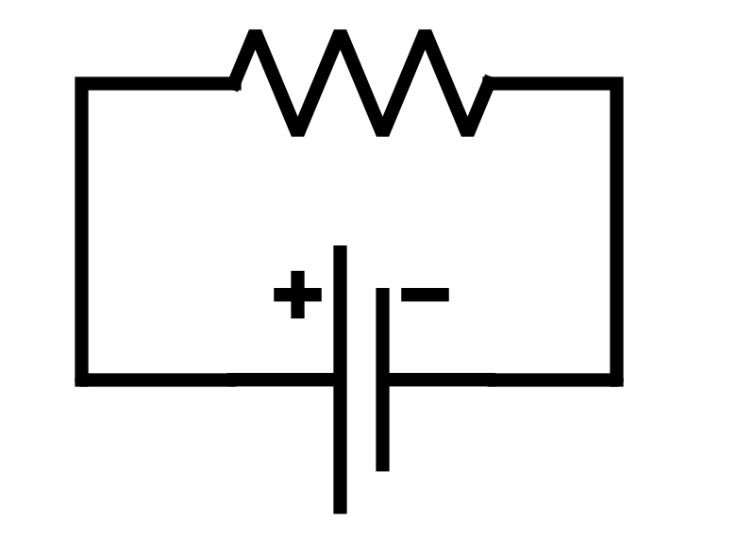
Drawing a load on an electrical schematic

Slide 8
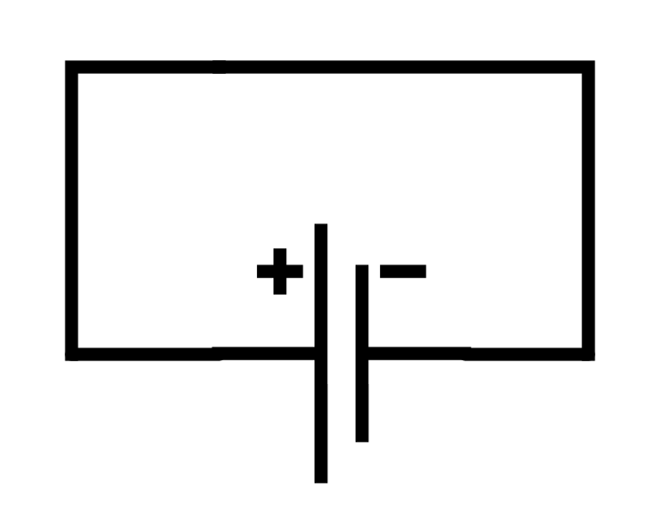
A bad drawing of a electrical schematic
A battery without a resistance, is called depending how many volts the battery is:
Short circuit
A Short
A Dead Short

Slide 9
Amp/Hours
The amount of capacity of a battery is measured in Amp/Hours.
Our FRC battery is 18 Amp/hours.
If we have a 1 Amp load, we can run that for 18 hours.
If we have a .5 Amp load, we can run that for 36 hours.
If we have a 120 Amp load, we can run it for 9 minutes, which is why we need to change the battery every match

Slide 10
Ground and Positive
Out of the battery there are two connections
The Positive connection is the “source” of the electricity.
The negative connection is the “sink”, and is called the ground.
The ground is where to volts measure zero.
Like physical work, if a mass is above the ground it have potential energy.
If the mass is on the ground it has zero potential energy.

Slide 11
Circuit Breakers and fuses
Circuit breakers prevent shorts.
They have an amp rating
If you pull more amps than the rating the circuit breaker opens and stops the flow of amps.
The breakers are temperature sensitive.
Every one we will use is “slow acting” which means that if you pull 41 amps through a 40 amp breaker, it will take a long time to open.
If you pull 80 amps through a 40 amp breaker, it will open quite fast.
Note: The company Jim works for, Astronics, makes electronic circuit breakers for Airplanes, so Jim can talk a long time about circuit breakers.

Slide 12
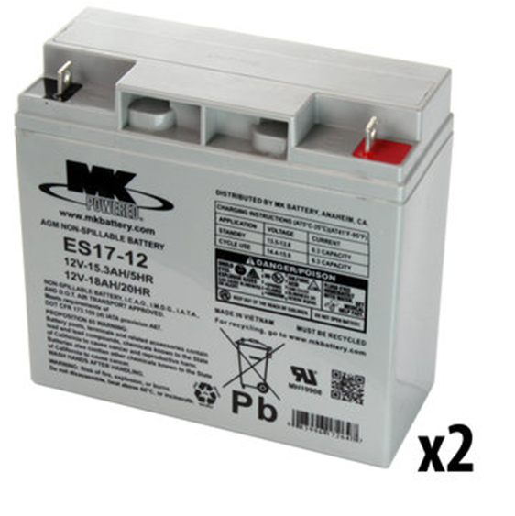
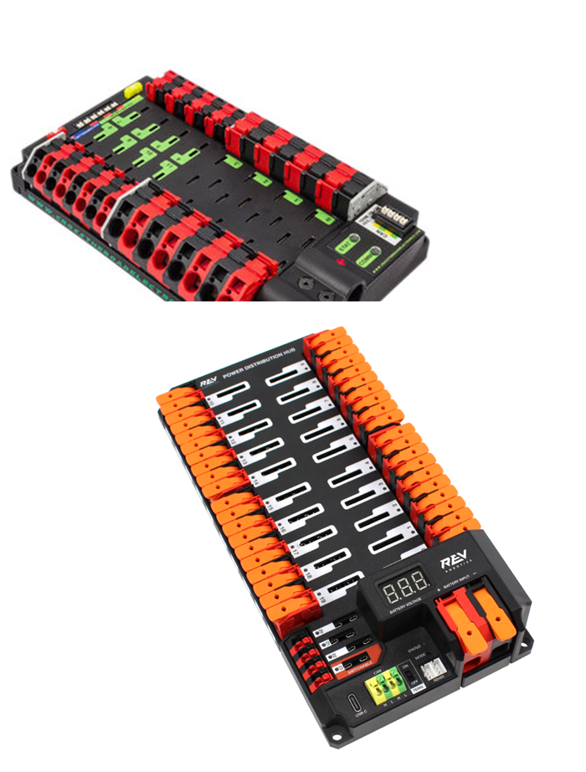
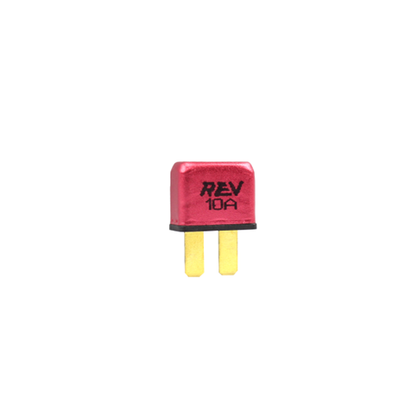
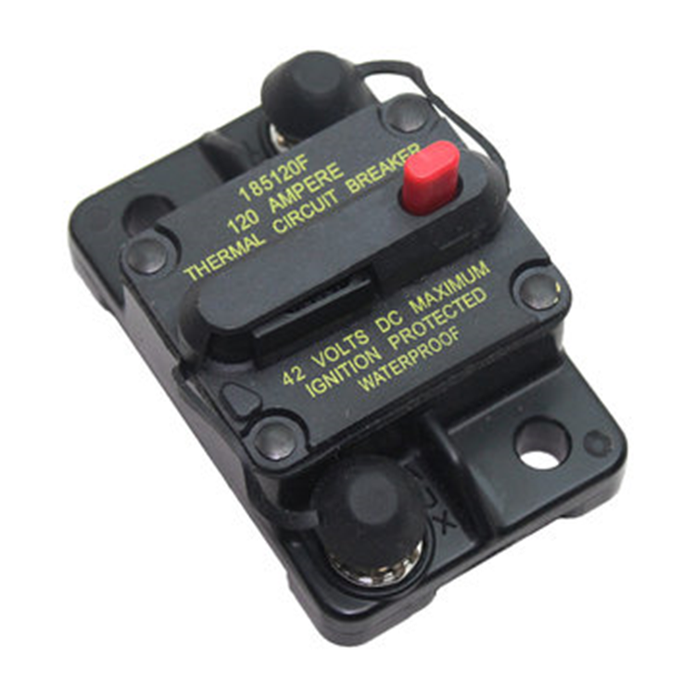
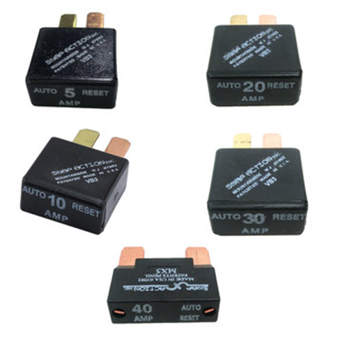
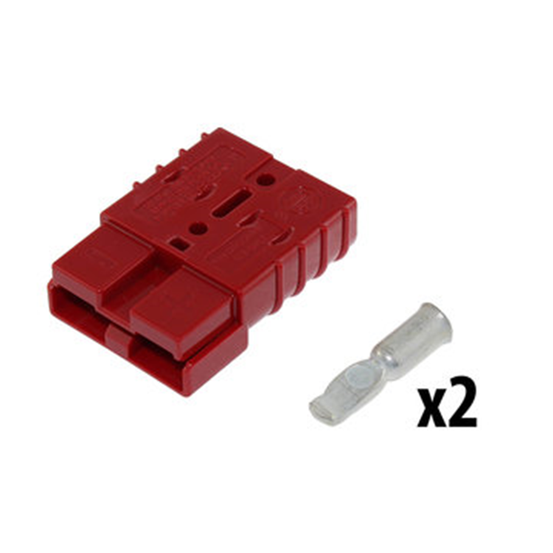
The Primary Distribution System
https://github.com/JimWright4089/FIRSTWorkshops

Slide 13
The Primary Distribution System
https://github.com/JimWright4089/FIRSTWorkshops

Slide 14
The Primary Distribution System
Gets the power from the battery to the Distribution Thingys.
The Battery is a 12V 18Amp/Hour. When fully charged its 14V, and while the robot is heavy driving can drop down to 10V.
The main breaker is a 120Amp slow acting breaker, which means it can handle short spikes above 120A.
We want the battery to be at 14-13V at the start of the match.
We can use either 6 gage or 4 gage wire. 4089 uses 6 gage.
https://github.com/JimWright4089/FIRSTWorkshops

Slide 15
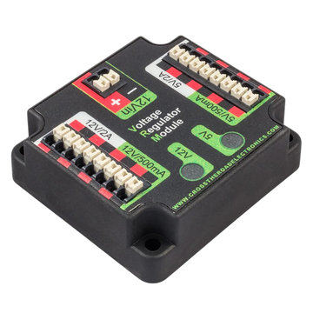
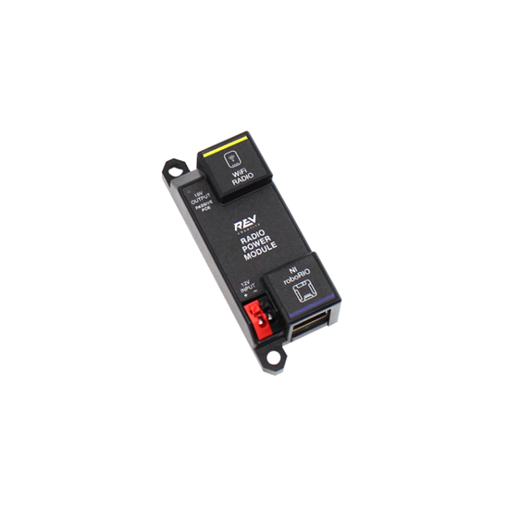
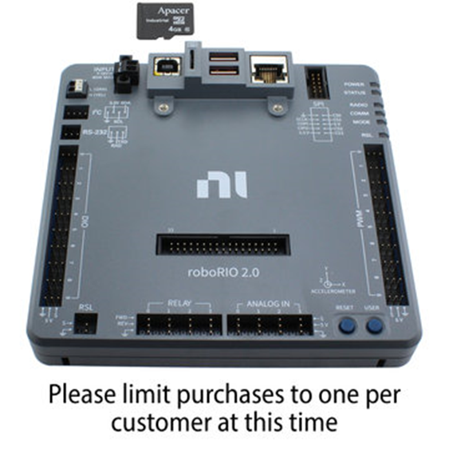
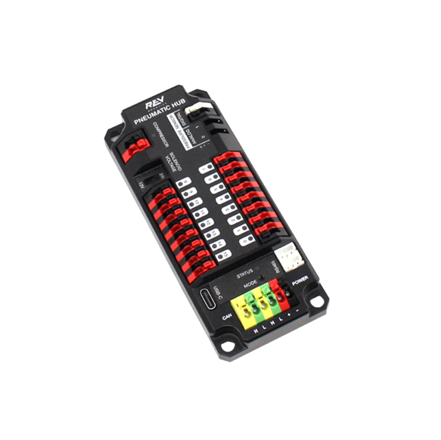
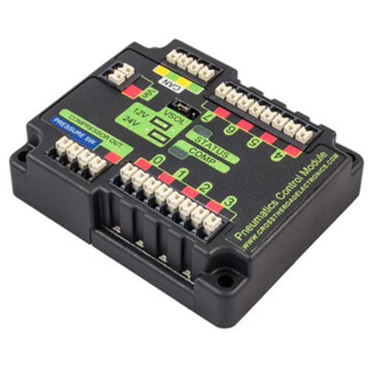
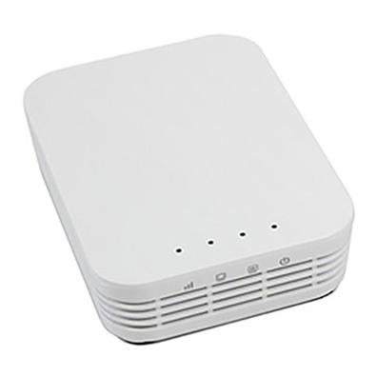
Regulated Secondary Power System
https://github.com/JimWright4089/FIRSTWorkshops

Slide 16
Regulated Secondary Power System
https://github.com/JimWright4089/FIRSTWorkshops

Slide 17
Regulated Secondary Power System
The distribution boards have a 12V regulator on them, that even if the main battery power goes under 12V, the regulators will put out 12V power.
The fuse ports on the distribution boards can only connect to these devices.
Extra Voltage Regulator Modules (VRM) and Pneumatics Modules can be added but only to the Non-Regulated ports.
https://github.com/JimWright4089/FIRSTWorkshops

Slide 18
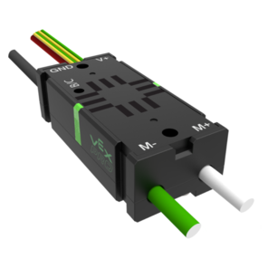
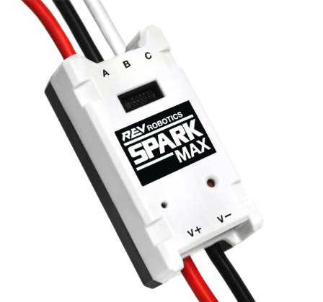
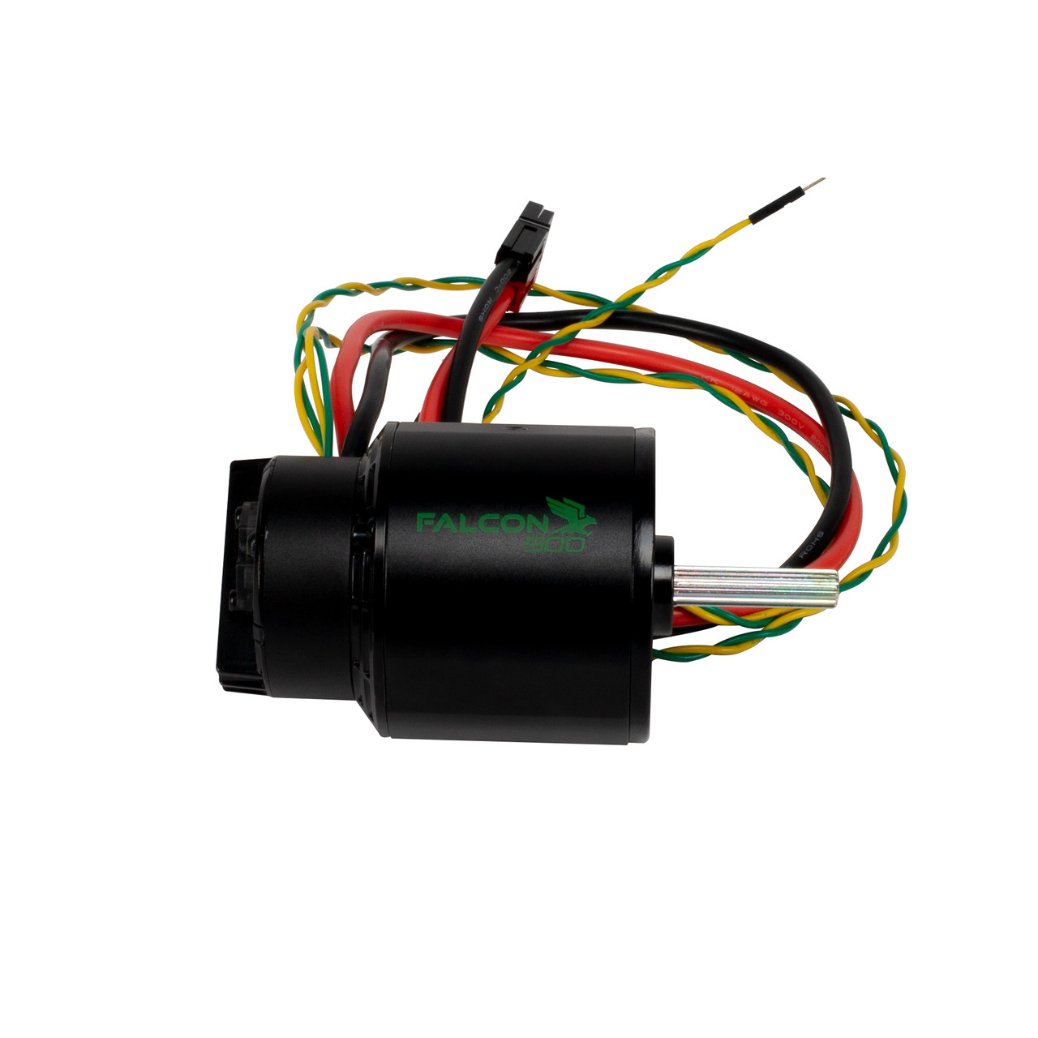
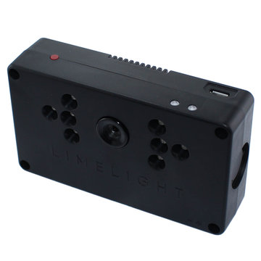
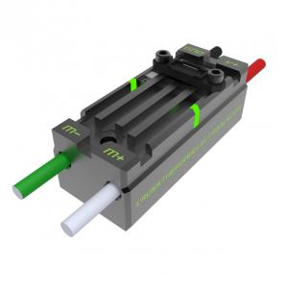
Secondary Power System
https://github.com/JimWright4089/FIRSTWorkshops

Slide 19
Secondary Power System
Mostly Motor Drivers.
Other things like LimeLights.
Circuit Breakers 5Amp, 10Amp, 20Amp, 30Amp, and 40Amp.
We need to look at each load to figure out the right breaker to use.
https://github.com/JimWright4089/FIRSTWorkshops

Slide 20
Minimum Wire Gages.
40Amp breakers need to have 12 gage wires.
30Amp breakers 14 gage wires
20Amp, and all he regulated devices (other than RoboRio) need 18 gage wires.
10Amp, 5Amp, RoboRio, any extra regulated devices 22 gage.
Sensor wires can be 28Amp.
All of these will use Red for positive, Black for ground.
https://github.com/JimWright4089/FIRSTWorkshops

Slide 21
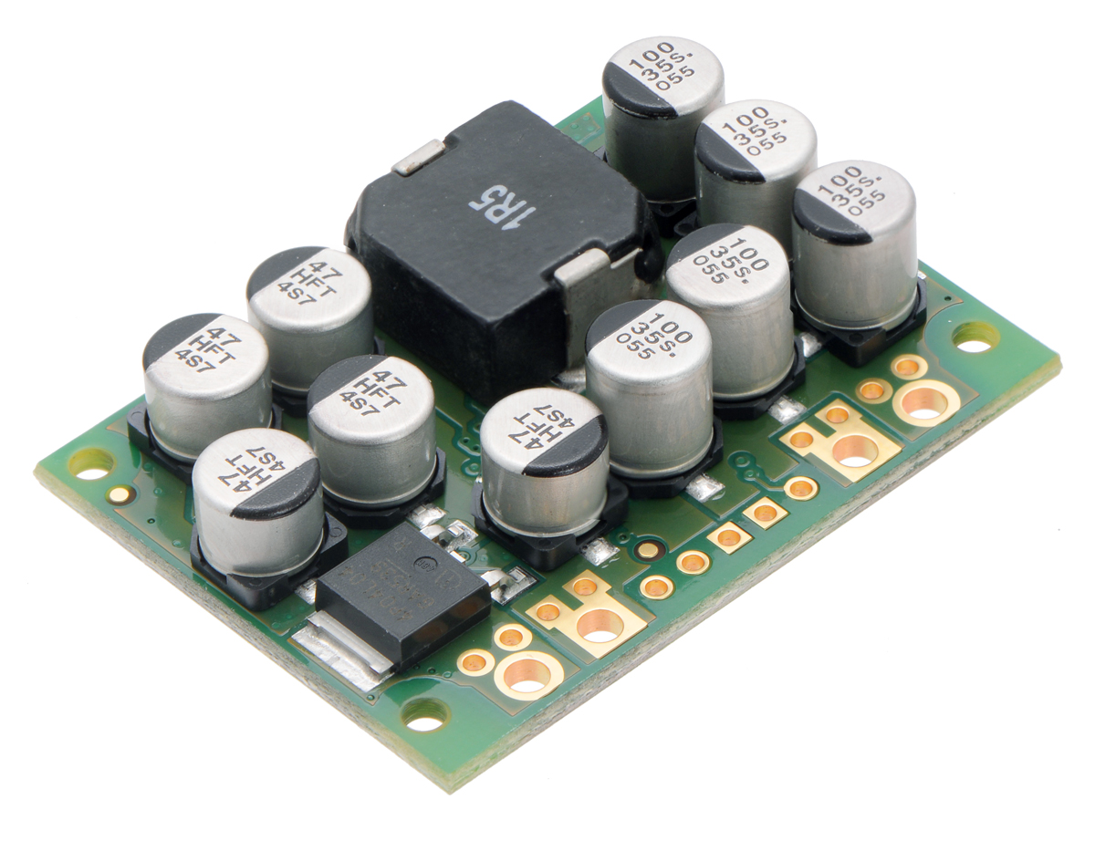
5V bus
Arduinos and Raspberry Pis need to run on the 5V bus.
Sources:
Two 1Amp ports on the Voltage Regulator Modules.
Two .250 Amp ports on the VRM as well.
Pololu 15 Amp Step down module.
https://github.com/JimWright4089/FIRSTWorkshops

Slide 22
Connecting it into a FRC robot The Rules/Pro Tip
R624
All non-SIGNAL LEVEL wiring with a constant polarity (i.e., except for outputs of relay modules, motor controllers, or sensors) shall be color-coded along their entire length from the manufacturer as follows:
A. red, yellow, white, brown, or black-with-stripe on the positive (e.g. +24VDC, +12VDC, +5VDC, etc.) connections
B. black or blue for the common or negative side (-) of the connectionsBasically, the RoboRio MUST controls ALL actuators (even servos).
My company (Astronics) has a unwritten rule that, all Aircraft Power (28Volt usually) is Red/Black. All 5V power is Orange/Black so they don’t mix.
I would suggest Yellow/Blue for your 5V power bus.
https://github.com/JimWright4089/FIRSTWorkshops

Slide 23
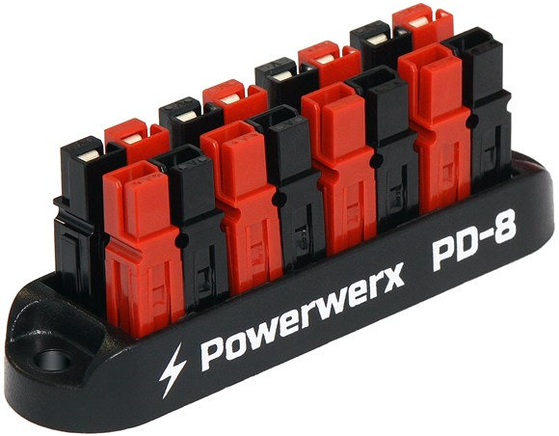
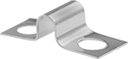
Connecting it into a FRC robot 5V Power Bus
Anderson Quick Connects come in other colors than Red/Black.
https://powerwerx.com/anderson-powerpole-colored-housings
Anderson Quick Connect Bus
https://powerwerx.com/8-position-powerpole-distribution-block
Terminal Blocks
From McMaster or most local Hardware Stores
McLendon Hardware has a good selection
Termal Block Jumpers
https://github.com/JimWright4089/FIRSTWorkshops

Slide 24
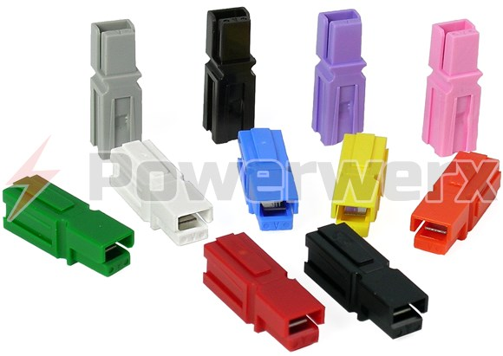
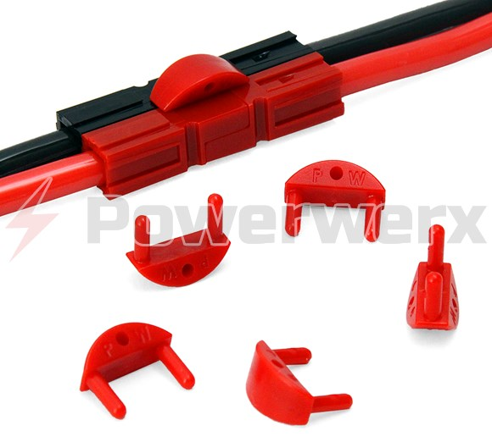
Wire Connectors
We would like to use Anderson Powerpole connectors.
We also want to connect each load to the same distribution port if we have to rewire the robot at some point.
Every port will have a certain color pattern.
The load will have the same pattern so people have a visual clue what goes where.
We will use the Powerwerx Retention Clips to keep the wires together.
https://github.com/JimWright4089/FIRSTWorkshops

Slide 25
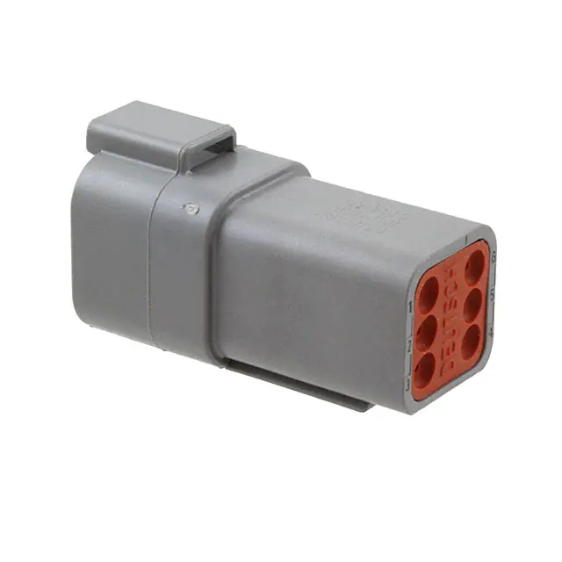
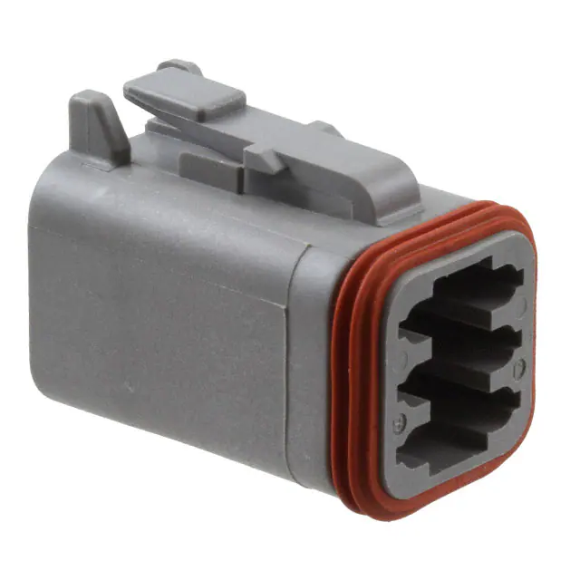
Connecting it into a FRC robot TE Con Deutsch Connectors
Digikey sells the best selection
Part Numbers for the 6 pin.
DT04-6P – Socket Shell
W6P – Wedge Lock
DT06-6S – Plug Shell
W6S – Other Wedge Lock
0462-201-16141 Socket Pin
0460-202-16141 Pin
Crimp tool is expensive on Digikey. Cheaper one:
https://www.customconnectorkits.com/902-499/
https://github.com/JimWright4089/FIRSTWorkshops

Slide 26
CAN bus
The CAN bus starts at the RoboRio and ends at the Distibution Board.
Motor Drivers and the Pneumatic devices are connected to the bus in between.
The CAN bus has a high wire (yellow), and low wire (green).
They all chain together.
https://github.com/JimWright4089/FIRSTWorkshops

Slide 27
CAN bus
Everything on the bus needs a unique ID
Cross the Road devices are configured with their tool.
Rev Robot devices are configured with the Rev Tool.
The configuring the CAN bus is the “fence” between us, the electrical team, and the software team.
4089 has a rule of thumb, where devices on the left side of the robot have odd IDs and right side has even IDs
4089 has a rule of thumb, drive motors are in the 20s. Other motors have 10s (or 30s I need to look at which it is).
Other things can fall into the single digits.
Don’t use ID 0
https://github.com/JimWright4089/FIRSTWorkshops

Slide 28
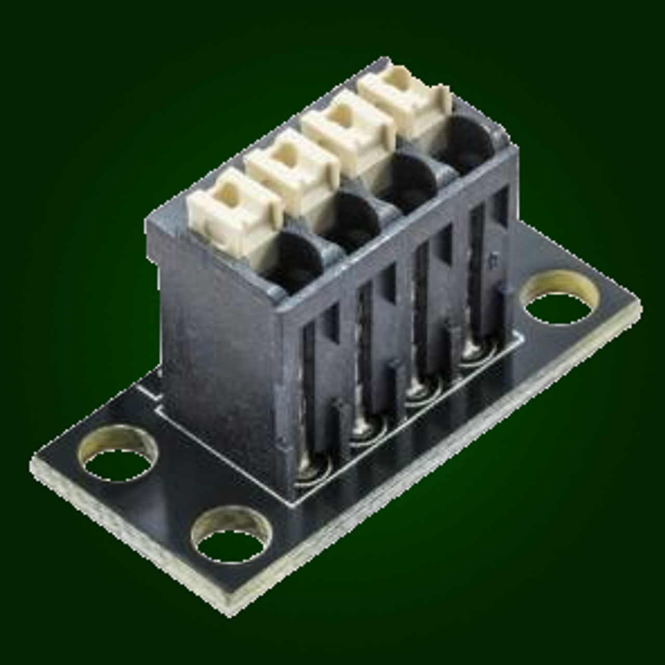
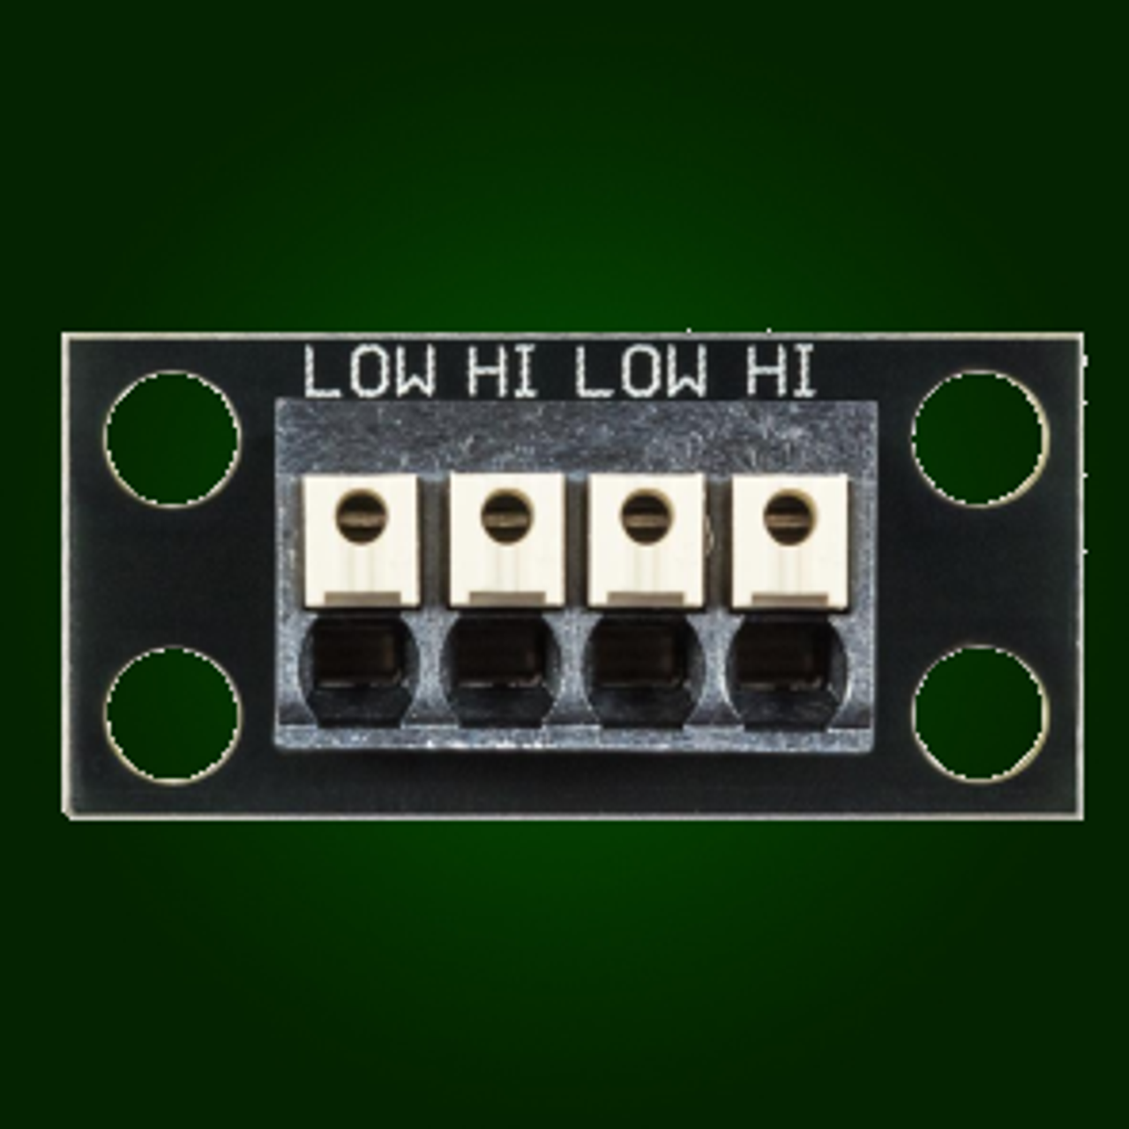
CAN bus
To connect up the bus on the robot we will use the CTR bus connectors.
The first device goes into the first two ports (Green then Yellow).
The second device, or connecting wire goes into the last two ports.
When you put the wire in, pull really hard on it to ensure its in.
https://github.com/JimWright4089/FIRSTWorkshops

Slide 29
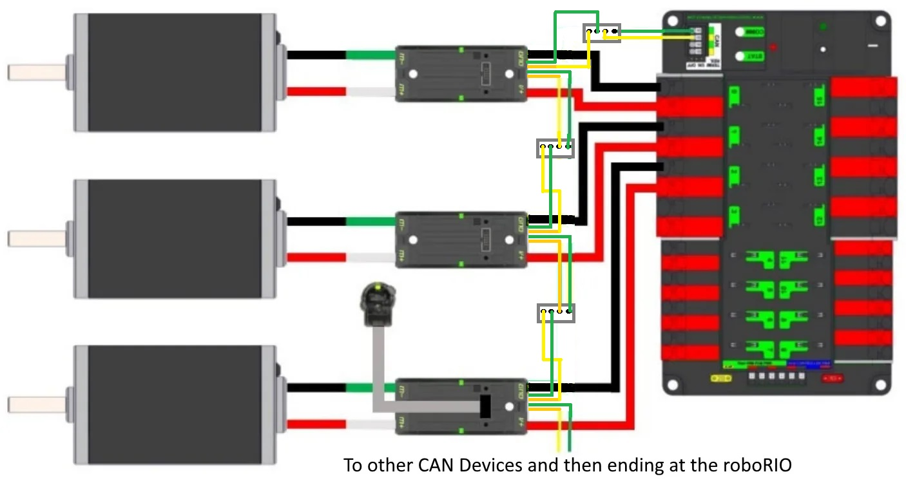
CAN bus connections
https://github.com/JimWright4089/FIRSTWorkshops

Slide 30
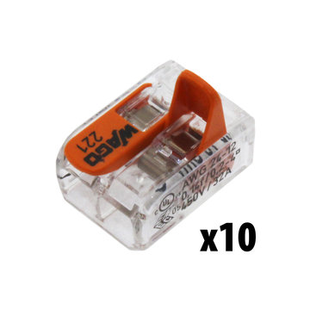
CAN bus
Emergency repairs of the CAN bus like we had at the District Champs last year.
For emergency repairs, put these wago connectors into the can bus.
Put both green wires into one, use another for both yellow wires.
Electrical tape both into place, if there is time.
https://github.com/JimWright4089/FIRSTWorkshops

Slide 31
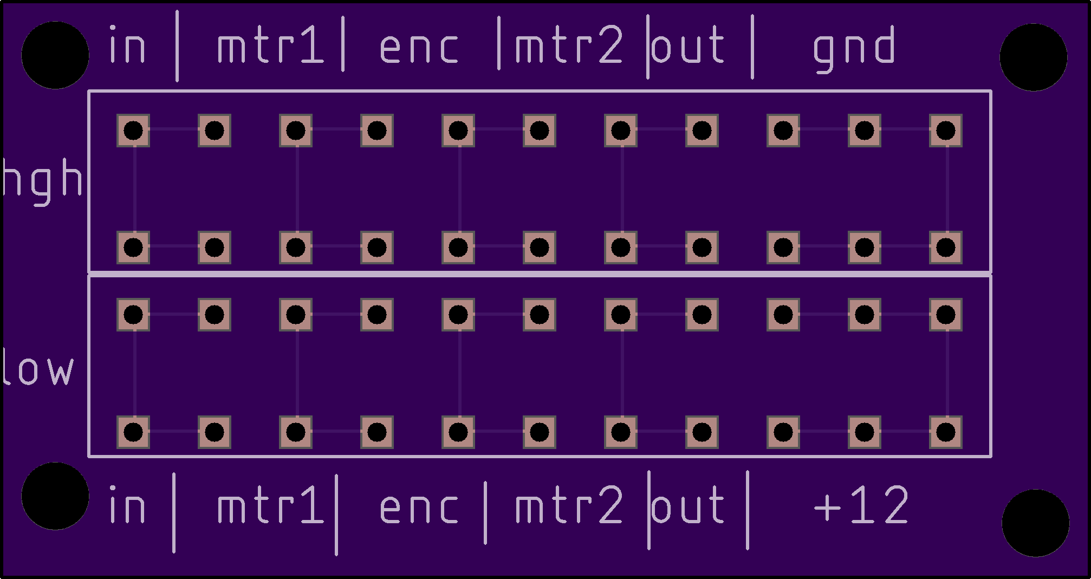
CAN bus on the swerve drive.
CAN wires for two motors and the encoder is six pairs of wires by themselves.
Plus the input can bus and output can bus.
We are having this board made.
The green wires so into the bottom, Yellow in the top.
The last three ports are for the power for the encoder.
This reduces the five CTR CAN connectors as well as soldering in a branch to the power wires.
https://github.com/JimWright4089/FIRSTWorkshops

Slide 32
Engineering Notebook
The electrical team is responsible to document the following:
What devices are on which power port.
What breakers are on each port
The order of the CAN bus.
The CAN ID of each device.
We want this in the notebook not on line, so during an emergency repair everyone knows where the “golden chart” is.
If we had this in an electronic version we have to worry about the latest release of this.
If there is a change to the chart. We cross out the old chart in the book and we make a new chart.
https://github.com/JimWright4089/FIRSTWorkshops

